Slide 1

Cultural tourism
Beit She’an Valley
Final meeting of the SPOT project
30th November 2022
BIU team
Department of Geography and Environment
Insights of specific groups of stakeholders

Slide 2
Insights of local and regional stakeholders
Business owners’ insights
Flexibility and “thinking outside the box” (initiated by the effects of COVID-19):
  Developing and updating working methods
  Changing or developing new products
  Changing marketing methods:
  Increasing business visibility on social media
  Collaborating with other businesses
  Enhance the innovative character of enterprises
In the future, the current situation and its effects and experiences can serve as valuable lessons for potential entrepreneurs

Slide 3
Insights of authorities’ officials
1. Improve inter-relationships between enterprises and local municipality bodies in order to achieve:
  Supportive environment for public and private businesses
  Better cooperation during a major crisis
  More resources for sustainable outcomes of cultural tourism projects
2. Officials in the field of tourism must be appointed
4. The negligence of a number of local tourist assets must be solved
5. Political issues and internal intrigues that inhibit long-term planning should be reconsidered
6. Managers of regional government bodies should be residents of the area
7. Local municipalities demonstrate an inadequate systematic marketing strategy at the national level
8. There is a lack of long-term data and a lack of knowledge-based planning.

Slide 4
Civil society’s insights
“What will be the impact of an increase in cultural tourism on the region?”
73% of Beit-She'an town residents and 47% of Emek HaMaayanot suggested: Higher numbers of cultural tourists will be very positive to local and regional development.
Increase employment in the area
Decrease out-migration from the area
Improve local residents’ standard of living
Rebrand the town of Beit-She’an

Slide 5
National stakeholders
Business owners’ insights
Improved links between enterprises and national policy-making bodies is required in order to achieve support in a number of fields: financial, knowledge, information, management and marketing.

Slide 6
Insights of authorities’ officials
1. National authorities can contribute by:
More supportive environment for public and private businesses
Bodies that support businesses could develop programming that emphasize evaluation, monitoring and developing of marketing "tools" for tourism-related projects.
2. The fact that tourist activity is partly managed and promoted by state bodies
has a number of effects on the tourism sector in the region:
These bodies are in a better position to hire high-skilled external professionals to develop and maintain local and regional assets
Better coordination of the mass events is required in order that particularly the town municipality will benefit from these events
Managers of regional government bodies should be residents of the area

Slide 7
continue
Both municipalities demonstrate an inadequate systematic marketing strategy at the national level. There is no exhaustive platform that provides in one place all required information for potential visitors in an easy and tractable manner.
There is a lack of long-term data and knowledge-based destination planning.
There is a dearth of government support and management in this area. This includes subsidized loans, workshops, and mentoring from the phase of planning till the ongoing operation.

Slide 8
Civil society
The need to change the image of the area in the eyes of local visitors was emphasized. The residents argued that the development of tourism that presents the heritage and traditions of the various communities can contribute to this change (interview with residents of the city of Beit She’an, residents of kibbutzim and moshavim)

Slide 9
European and international stakeholders
Business owners’ insights
"Bridge to Peace" - an agreement between Israel and Jordan for the restoration and development of the Jordan River. The decision has an impact on initiatives to develop peace tourism based cultural and heritage activities.
This initiative was expressed in interviews with decision makers at the national and local level.

Slide 10
Insights of authorities’ officials
In various interviews, the need to strengthen the exchange of information between international and national level like UNESCO and ICOMOS for the development of tourism in heritage sites in the Beit-She'an Valley was emphasized (interviews with the mayor of Beit-She'an city, the regional council, the director of the drainage authority, the director of the antiquities National Park).

Slide 11

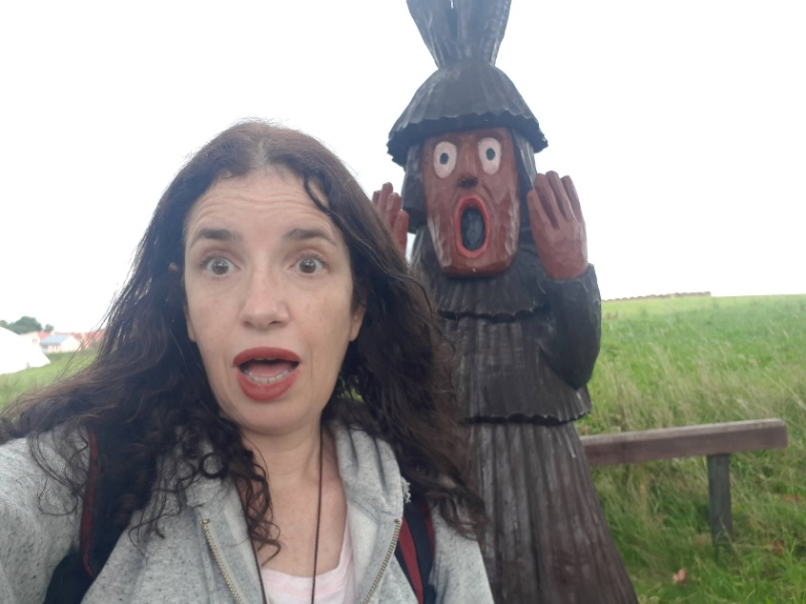
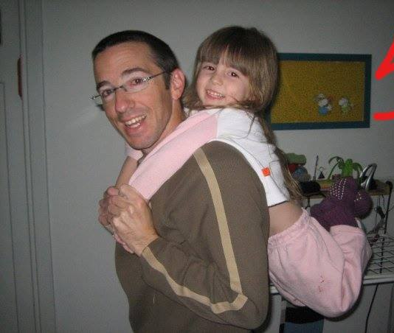
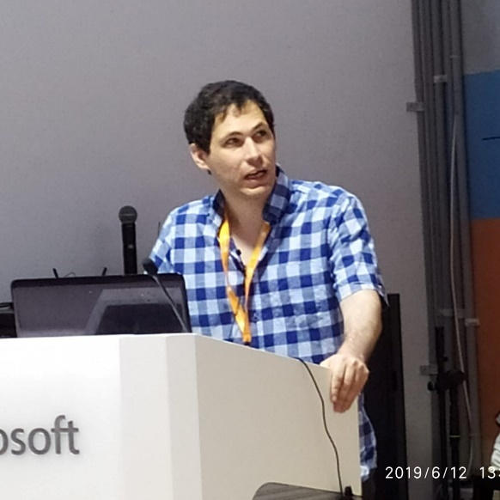
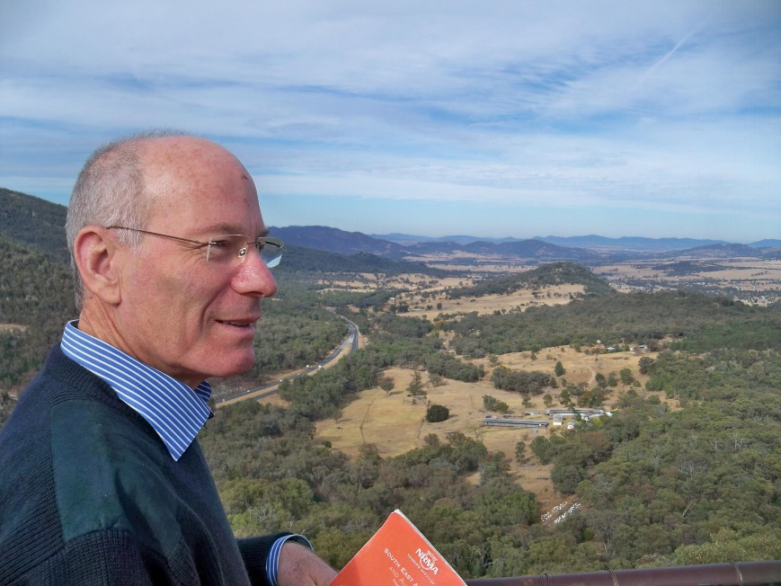
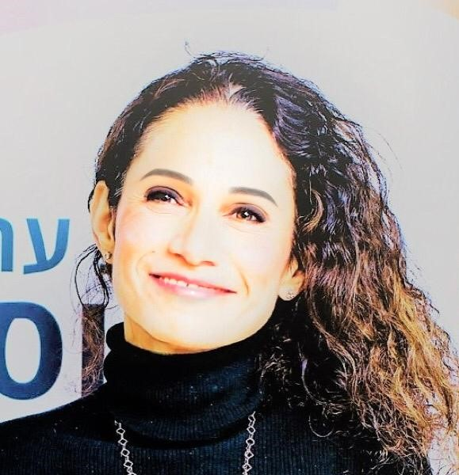
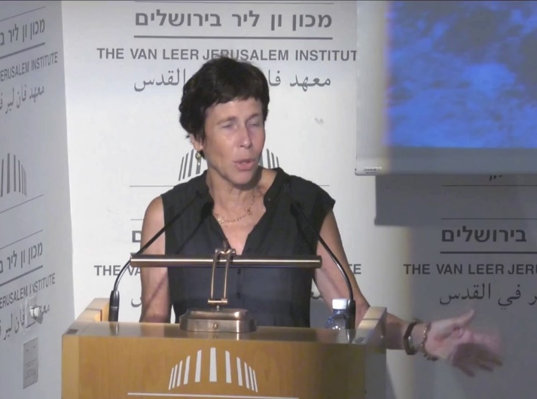
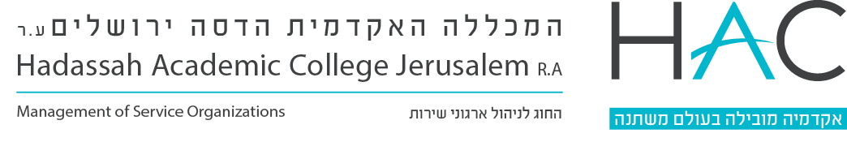
Dr. Irit Shmuel
Dr. Yaron Michael
(Soon to be Dr.) Shilo Shiff
Prof. Irit Amit Cohen
Prof. Michael Sofer
Prof. Anat Tchetchik

