Slide 1
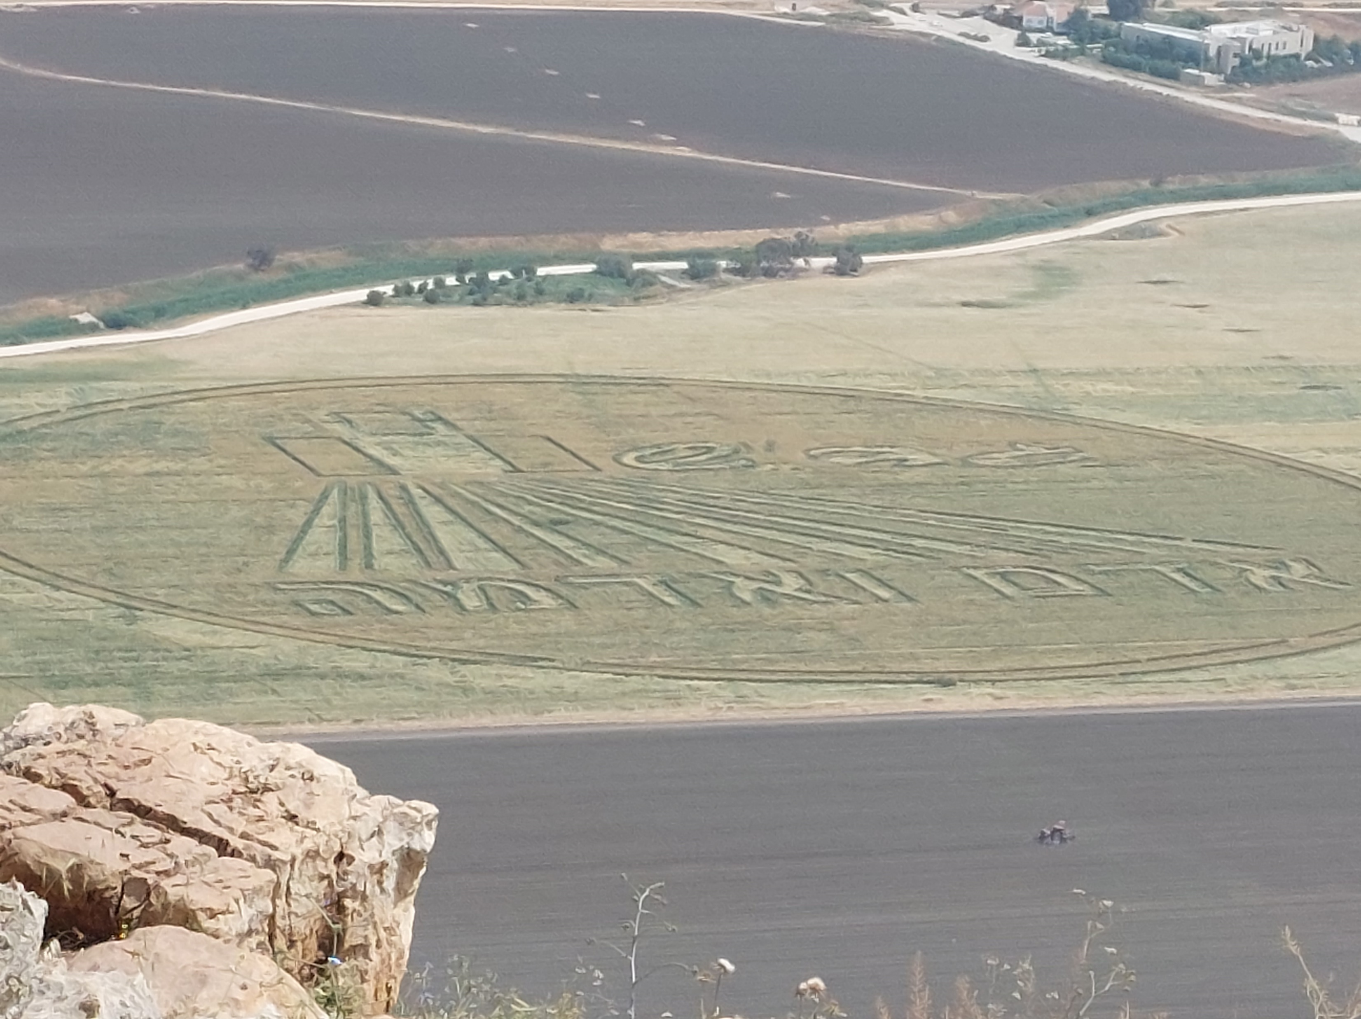
COVID-19 and the impact on cultural tourism: The case of Beit She’an Valley, Israel
Irit Shmuel
Michael Sofer
Irit Amit-Cohen
Anat Tchetchik
Shilo Shiff
Yaron Michael

Slide 2
The SPOT project
Notes:
The research was conducted as part of the “SPOT PROJECT”
SPOT is 3 years EU-funded project under the Horizon 2020 program, focused on the study of problems related to cultural tourism.
There are 15 partners from different countries in Europe including Israel.
Among the main goals of the project are:
Giving a role to local communities
Expanding the concept of cultural tourism
Building in the role of stakeholders
Developing an interactive and dynamic view of cultural tourism

Slide 3
Research objectives:
To track trends and “survival strategies” in cultural tourism in a peripheral area of Israel during the Covid-19 pandemic.
To focus on the perspectives of:
Tourism businesses
Local residents
Notes:
This research is focused on emerging trends and adaptation strategies in cultural tourism in a peripheral area in Israel during the Covid-19 pandemic.
Since the tourism industry and the local community mutually depend on each other in peripheral areas (Prideaux, 2002), we focus on the responses of both tourism businesses and local residents to Covid-19.

Slide 4
Research questions:
What were the responses of local residents and cultural tourism business owners in the wake of Covid-19?
What were the survival strategies business owners used to adapt to the ongoing crisis?

Slide 5
The effect of Covid-19 on cultural tourism: the case of Israel
The income from tourism in 2019 was estimated at NIS 33.5 billion (€8.7 billion)
The number of jobs in tourism was estimated at 150,000.
The impact of Covid-19 on the tourism industry: both foreign tourism and domestic tourism ceased completely.
Notes:
The tourism industry is of great importance for the Israeli economy.
In 2019 there were 18 million domestic overnight stays and 9.1 million visits to national parks (Central Bureau of Statistics, 2021).
The Israeli income from tourism in 2019 was estimated at NIS 33.5 billion (8.7 billion €), about 2.5% of the GDP.
The number of jobs in tourism was estimated at 150,000, 3.8% of all jobs in Israel's economy (Central Bureau of Statistics, 2020).
The impact of Covid-19 on the tourism industry in Israel was devastating and disproportionate; foreign tourism ceased completely, and domestic tourism also declined for many months.

Slide 6
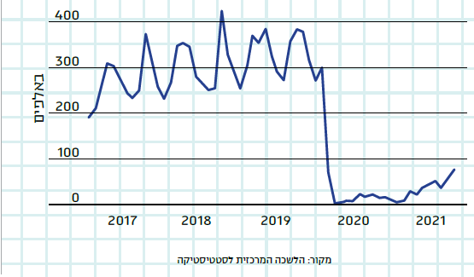
Israel’s Incoming Tourism 2017-2021
https://www.makorrishon.co.il/opinion/434567/
Notes:
As you can see, the number of tourists decreases dramatically to zero tourists for quite a long time till a recent recovery .
These are the numbers for inbound tourism.

Slide 7
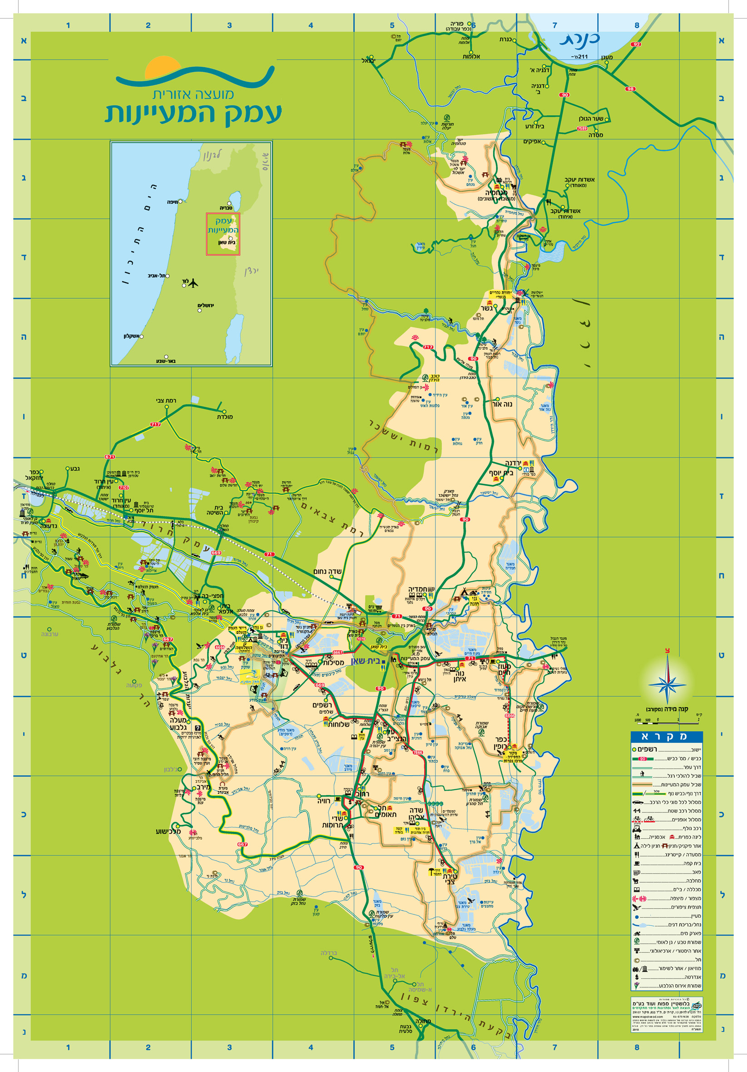
Notes:
The case study area of our research is the Beit She’an Valley.
This is a peripheral region, relatively far from the core of the country and the centre of economic activities
The area consists of two municipalities:
The town of Beit Sh’ean (population size 18,643 in 2021)
And the Emek HaMaayanot regional council (rural municipality) (population size 14,464 in 2021)
The regional council is comprised of 24 rural settlements, most of which are kibbutz type settlements.
The Beit She’an Valley is part of the Jordan River Valley in the Northern District of Israel.
This area is a well-known global corridor for seasonal bird migration.

Slide 8
Notes:
The map illustrates the case study area including the different types of settlements in the regional council.
Kibbutz is an Israeli collective settlement, usually agricultural and often also industrial, in which all wealth is held in common.
Moshav is a type of agricultural settlement.

Slide 9
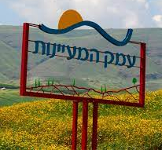
socio-economic index
The town of Beit Sh’ean
Cluster 4
Population: 18,643
The Emek HaMaayanot regional council
Cluster 6
Population: 14,464
Notes:
The region is considered a peripheral area, relatively far from the core of the country and the center of economic activities.
On a socio-economic index of 1 to 10, the town of Beit She’an is ranked in cluster 4, and the Emek HaMaayanot regional council is in cluster 6.

Slide 10
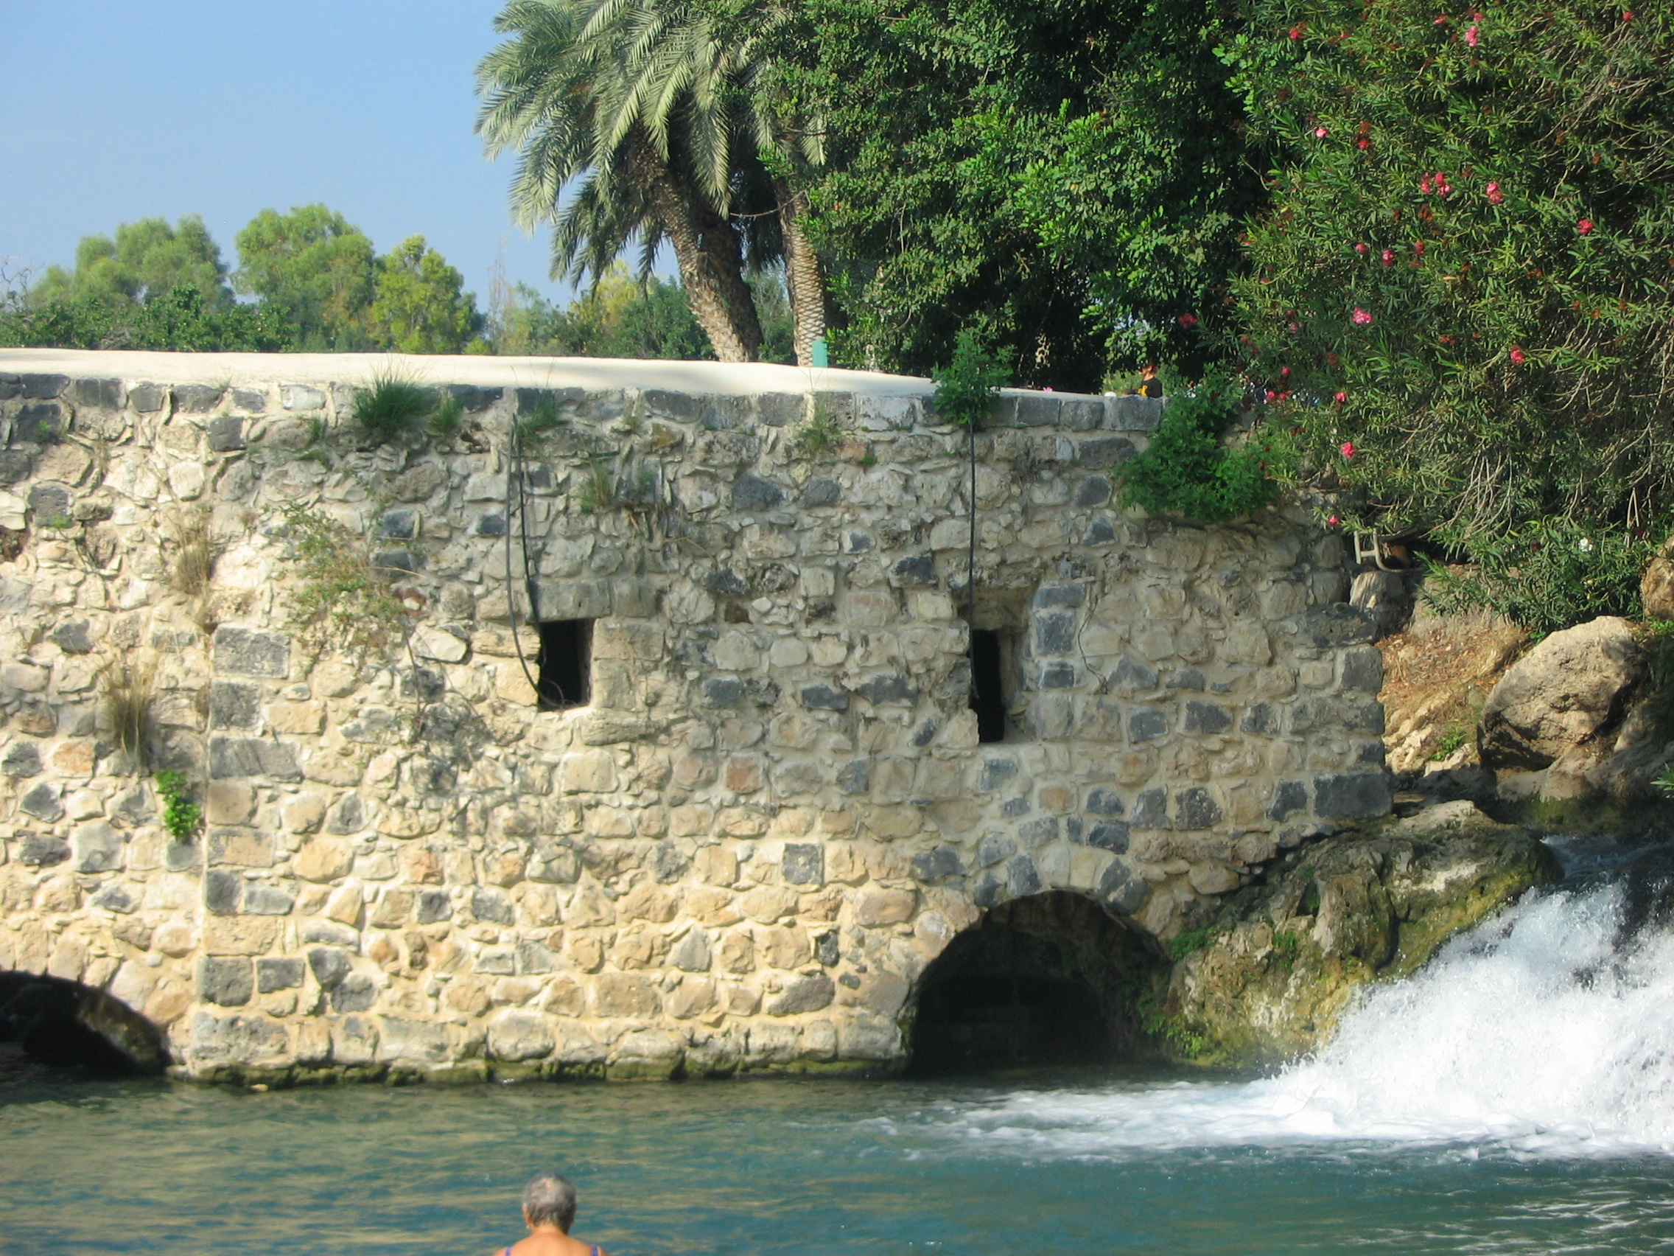
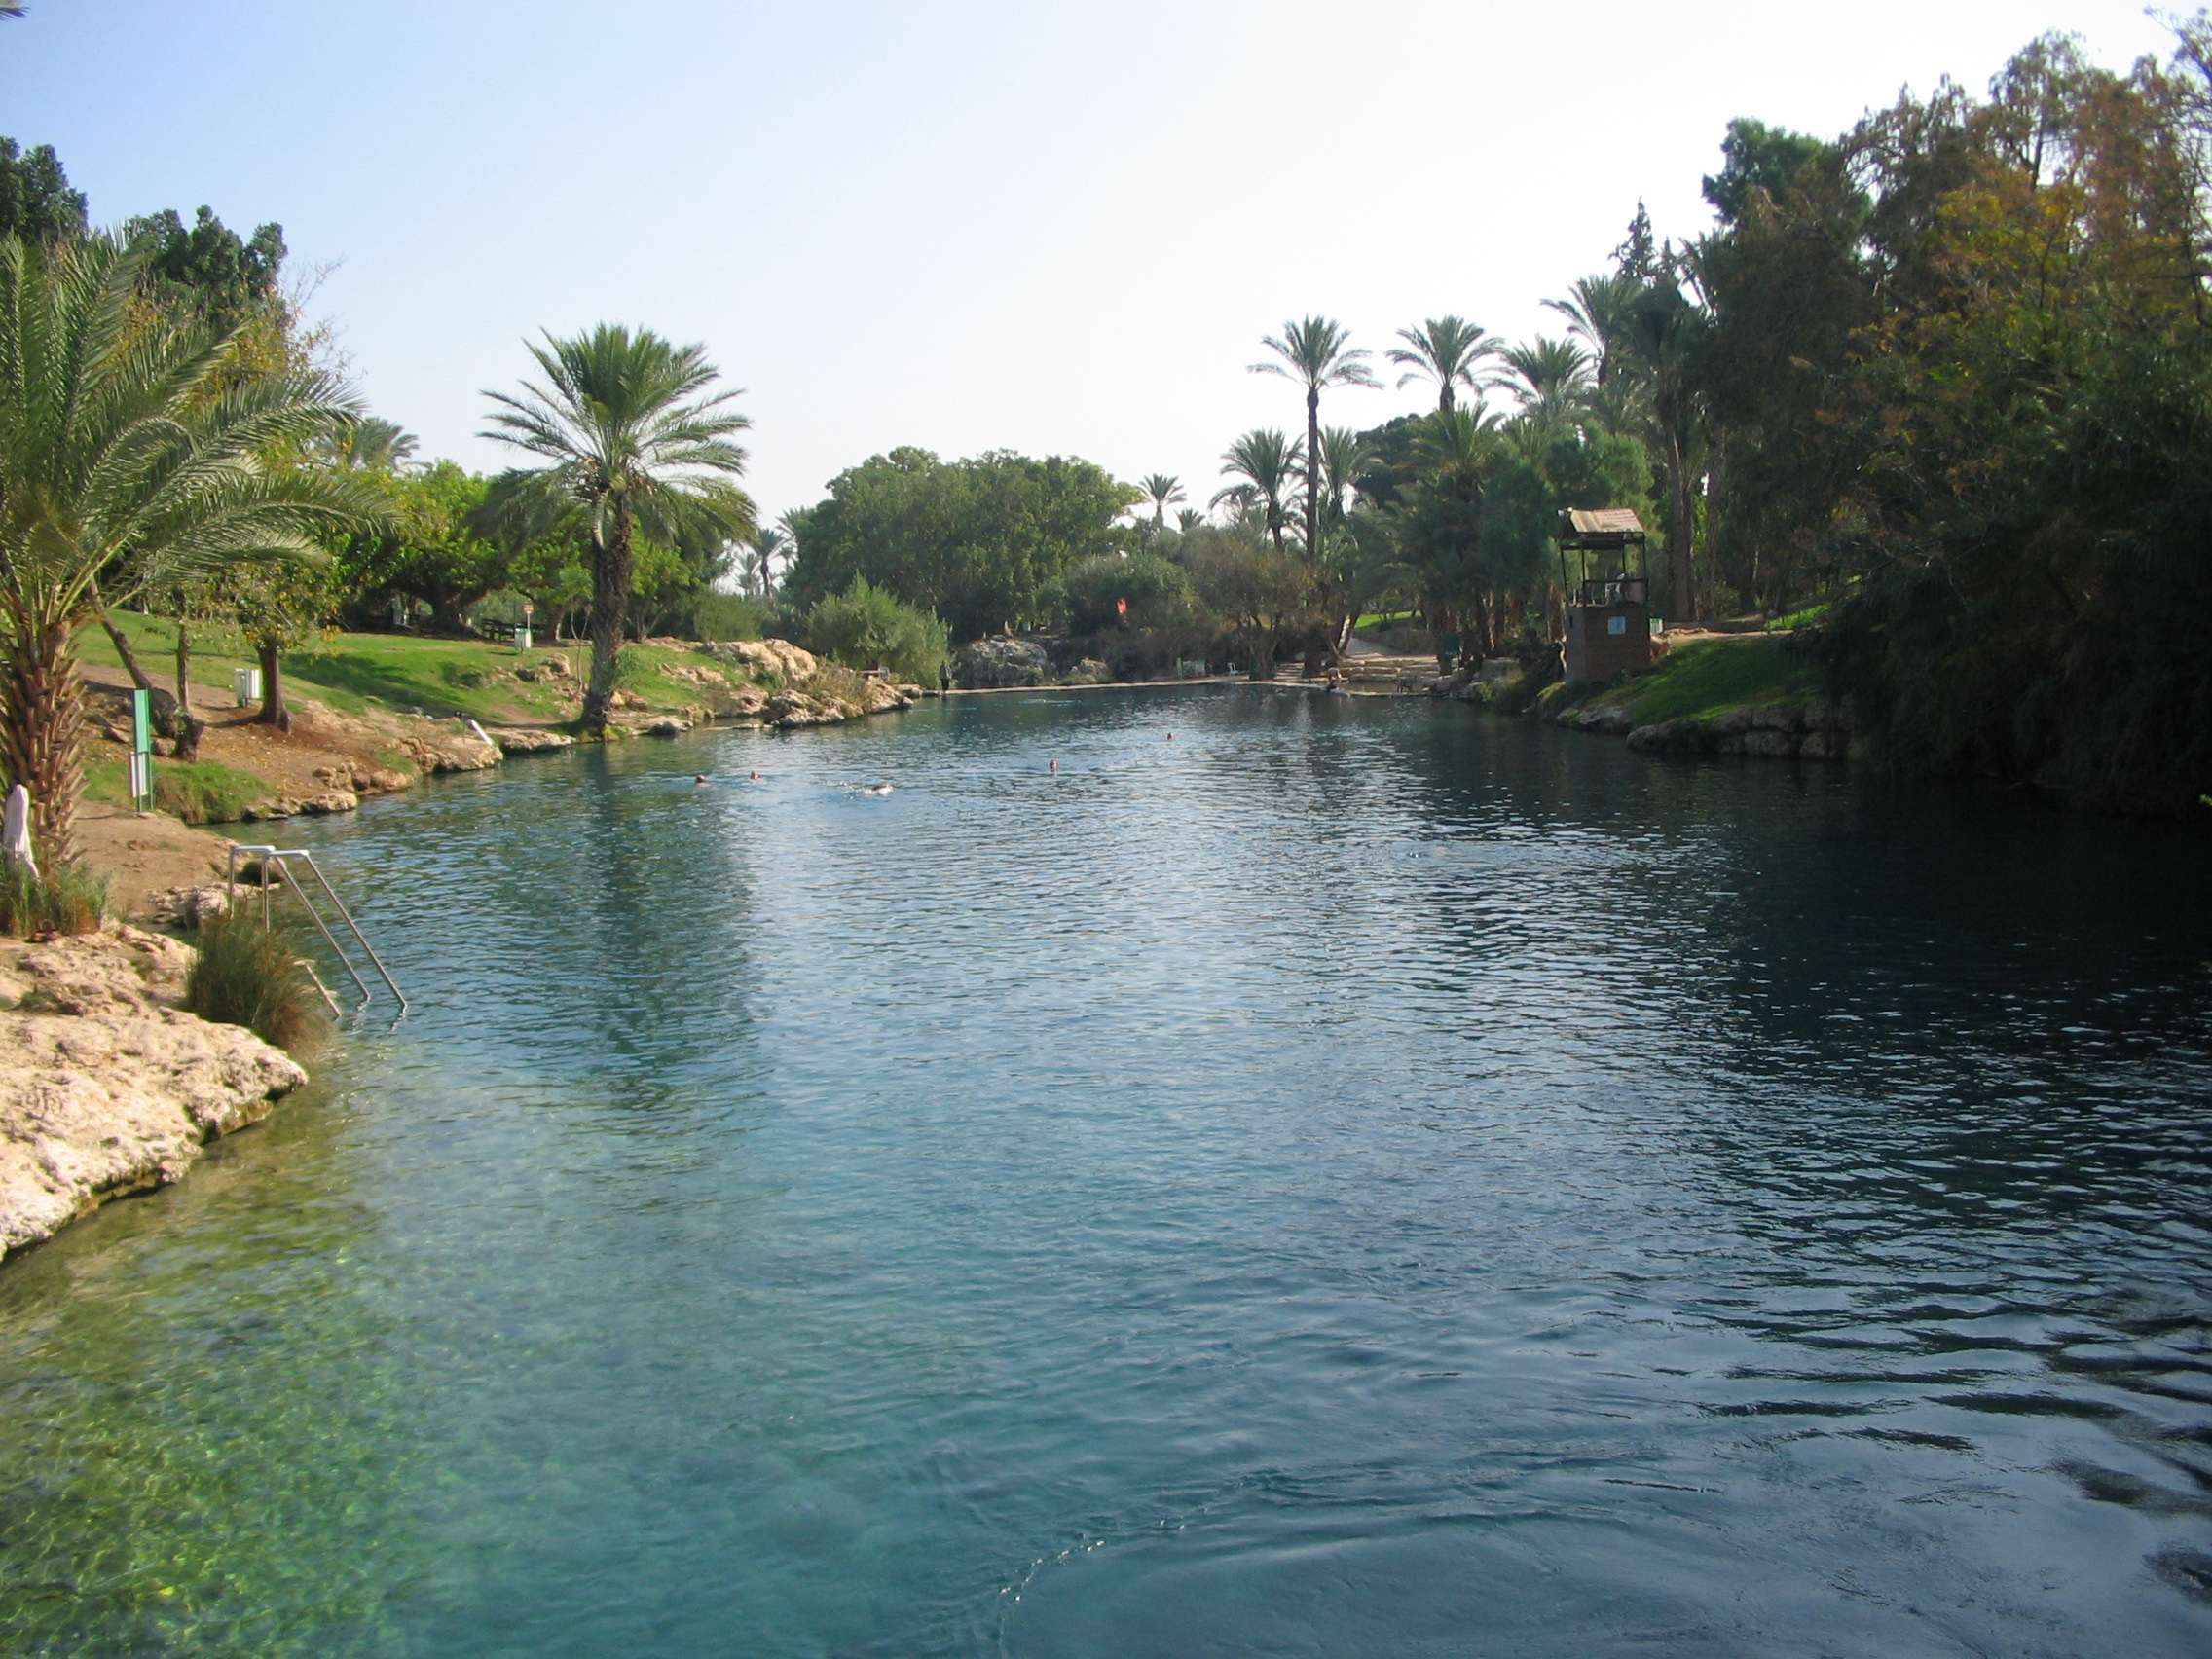
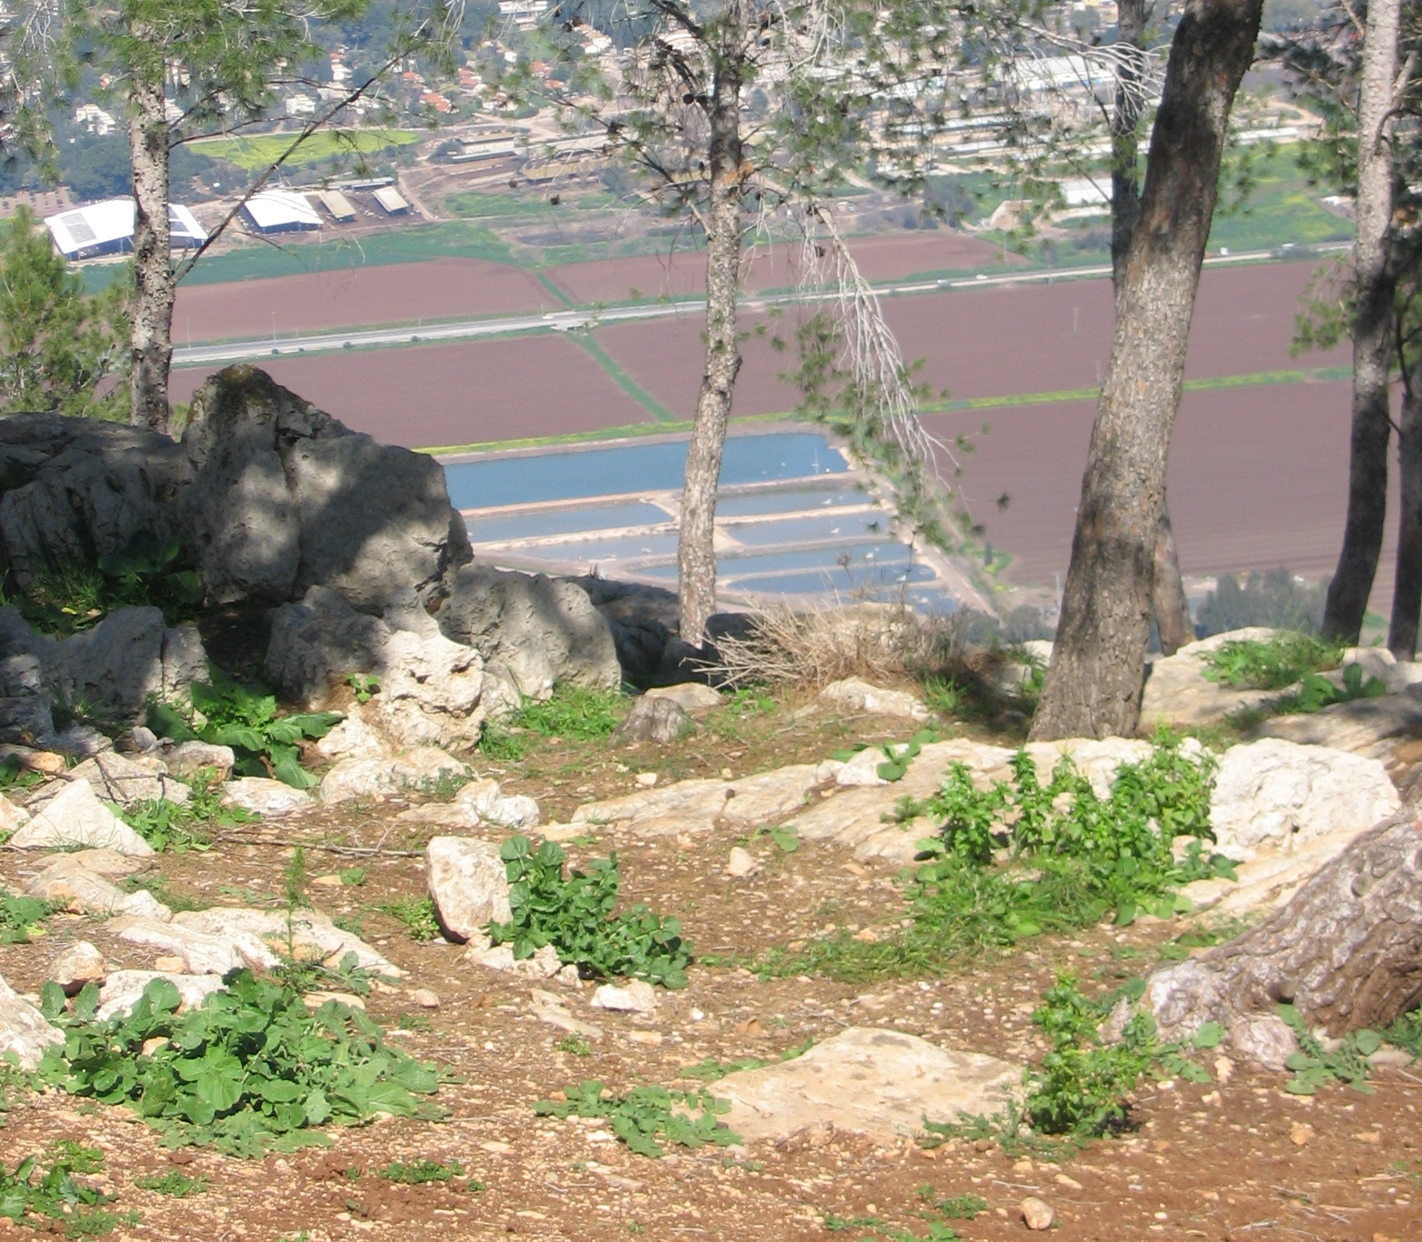
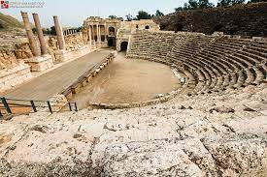
Notes:
The region offers diverse tourism sites and activities, most of which are natural and archeological.
The area holds more than 40 natural springs, birdwatching spots, historical sites, and beautiful flora and fauna.
There are more than a 100 attractions in the region.

Slide 11
Beit-Shean Attractions map
Credit: Meirav Yaniv Bridge to the Future
Notes:
Here you can get an impression of the varied tourism attractions in the town of Beit Shean.

Slide 12
Methodology
Two surveys that were distributed on-line among business owners and residents in the region.
Interviews with officials and a roundtable meeting with local entrepreneurs.
Notes:
Our methodology combines both quantitative and qualitative approaches.
The quantitative data was gathered based on two surveys that were distributed among business owners and residents in the region.
Under the Covid-19 restrictions, the surveys were distributed on-line.
The surveys were available on the Qualtrics.
44 completed questionnaires were obtained from business owners and 135 from residents.
The on-line survey was conducted in late 2020 and early 2021.
Qualitative data was obtained through interviews with officials in both municipalities and a roundtable meeting that was held with local entrepreneurs in order to obtain their wider viewpoints.

Slide 13
Results The impact of Covid-19 on businesses Businesses Profile:
About 70% of survey participants (N=44) are providers of tourist attractions, sites, or activities.
Business categories: Heritage, History, Artwork, and Gastronomy.
Most businesses are privately owned (57%).
Public sector businesses are 32% of the sample.
Most businesses were established in the last 20 years.
Notes:
Results - The impact of Covid-19 on businesses
About 70% of survey participants are providers of tourist attractions, sites, or activities.
This represents the distribution of tourism businesses in the area, with a limited number of accommodation services, and a high share of activities and attractions as well as tour guides.
Businesses in our sample indicated that the most important themes in their businesses are Heritage, History, Artwork, and Gastronomy
.Most businesses in our sample are privately owned (57%).
Public sector businesses (32% of the sample) include sites owned by either a government authority (e.g.- National Parks Authority) or the cooperative association of a kibbutz.
Family businesses are not very common, and the majority of businesses were established during the last 20 years.

Slide 14
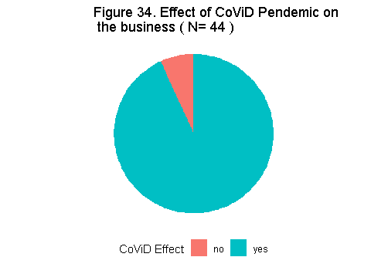
Notes:
All but 3 respondents reported being affected by the Corona pandemic.
It is worth noting, that lockdown policy in Israel was extremely strict and included travel distance limitation, resulting in a devastating effect on the tourism industry as a whole.

Slide 15
The impact of COVID-19 on the activities of the business (N = 35)
Notes:
All but three respondents reported being affected by the Covid-19 pandemic.
Businesses in our sample were heavily affected as most of them were shut down for long periods of time.
-The number of international and national visitors dropped.
There were low levels of bookings.
The rate of cancelled and reduced bookings correlated with the general effect of Covid-19 on all tourism-related businesses in Israel.

Slide 16
Uncertain future
Half of the owners reported that their financial reserves could last for 3 months or less.
Most of the businesses received no support from the government.
All businesses suffered from massive cancellations of all sectors ("unstable visitor traffic", "catastrophe“, "fear”).
Notes:
Regarding sustaining the business, about half of the owners reported that their financial reserves could last for 3 months or less.
These results are in line with their responses that most of the businesses received no support from the government.
About a quarter reported that their business would be able to survive one year or more.
Some businesses are owned by the public sector (e.g. – National Parks Authority), and therefore they can get financial support even during long shutdown periods.
At that time it meant that many businesses could close down, and it would take time for the situation to return to normal.
The majority of the business owners reported that they had to deal with massive cancellations they used terminology like: "unstable visitor traffic", "catastrophe" and "fear.“
Most of the canceled reservations were from organized groups, either foreign tourists or local groups such as retirees and workers' unions.
The cancellations included all tourism sectors: accommodations, food and beverage, museums, organized tours and more. Some cancellations were made at the last minute, so the business owners could not find alternative clients.

Slide 17
As one of the business owners stated:
"People cancelled at the last minute ... it creates an economic loss without being able to put someone else in place”.
Notes:
As one of the business owners stated: "People cancelled at the last minute ... it creates an economic loss without being able to put someone else in place."

Slide 18
Business owners’ survival strategies
Flexibility and “thinking outside the box”:
Developing and updating working methods.
Dividing large groups.
Changing or developing new products:
Picnic baskets, DIY kits and online products.
changing marketing methods:
Increasing business visibility on social media .
Collaborating with other businesses.
Renovating.
Notes:
Regarding the survival strategies and measures adopted in the course of business activities, flexibility and “thinking outside the box” were the mottos.
developing and updating working methods whether in pricing, working space (tending to shift the activities outdoors as much as possible), or dividing large groups into several smaller groups.
Here are two specific examples of flexible and adaptive thinking:
A hostel that rented out rooms long-term to companies’ workers
A museum manager that opened the site by request instead of by regular hours.
Changing or developing new products:
Some examples mentioned were picnic baskets that could be used in-house or in nature, home crafts or DIY (do it yourself) kits and online products, and services that send food to quarantined families.
The business owners had to change their marketing methods.
Many of them increased their business visibility on social media and other platforms in order to get more exposure and to retain customers.
An additional important strategy was collaborations with other business owners.
At the same time, some business owners took advantage of the closures for renovations.

Slide 19
The impact on residents’ activities
The residents’ questionnaire )N=153( focused on cultural tourism and the effects of Covid-19.
Respondents reported a decrease in participation in all categories of local cultural tourism during the Covid-19 period.
Notes:
The impact on residents’ activities
The residents’ questionnaire focused on cultural tourism and the effects of Covid-19.
The analysis is based on a relatively small sample, 73 respondents from the town of Beit She’an and 62 from the Emek HaMaayanot regional council; therefore, the results should be viewed with caution.
Respondents reported a decrease in participation in all categories of local cultural tourism during the Covid-19 period.

Slide 20
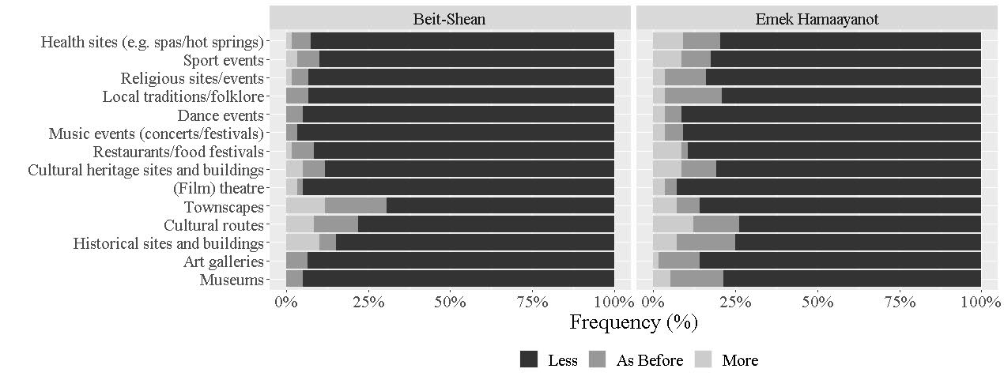
The impact of Covid-19 on residents’ cultural tourism activities
Notes:
The Figure shows that both populations were affected by the pandemic.
However, compared to the residents of the rural settlements in Emek HaMaayanot,
residents of Beit-She’an were somewhat more affected by the Covid-19 crisis and limited their cultural activities more than required by the Covid-19 restrictions.

Slide 21
The Impact on cultural tourism
“What do you think will be the impact of increased cultural tourism to the area?”
73% of Beit-She'an residents: Higher numbers of cultural tourists will be very positive.
Only 47% of Emek HaMaayanot residents gave the same response.
Notes:
Looking forward, the surveyed residents were asked about the possible impact of increased cultural tourism to the area (e.g., infrastructure, jobs, income, quality of life).
73% of Beit She'an residents believe that an increase in the number of cultural tourists to the area will have a very positive impact. In contrast, only 47% of the residents of Emek HaMaayanot thought the same.
The difference between these two groups may be due to the expectation of the residents of Beit She'an that tourism will serve as a major economic leverage for the region.

Slide 22
Increase employment in the area.
Decrease out-migration from the area.
Improve local residents’ standard of living.
Rebrand the town (Beit-Shean).
Notes:
Respondents repeatedly mentioned tourism as a means to improve employment in the area.
They also mentioned that in order to increase revenues for local businesses and reduce out-migration, the town of Beit She’an should invest in its appearance, improve residents’ standard of living, and rebrand the town. Many Beit she’an residents mentioned the town’s negative image.
Here too, the link between the image of a place - in terms of appearance, connection to the place, local pride - and tourism is emphasized.
This is especially true for the town of Beit She'an, due to the limited development of its attractions – such as sites from the Roman period and remains from the Ottoman and the British Mandate periods.

Slide 23
recommendations
Improve links between enterprises and administrative and policy-making bodies at different levels to acheive:
Better cooperation during a major crisis.
Supportive environment for public and private businesses.
More resources for sustainable outcomes of cultural tourism projects.
Enhance the innovative character of enterprises.
Develop programming that emphasizes successful evaluation, monitoring, and setting of marketing "tools" for (cultural) tourism-related projects.
Notes:
An important recommendation at the regional level is to improve the links between enterprises and administrative and policy-making bodies at different levels: local, neighboring settlements (urban-rural relations in our case study), regional and even national. Such links can serve as important assets during a major pandemic.
Benefits to the participating regions may include a more supportive environment for public and private businesses and more resources for sustainable outcomes of cultural tourism projects.
An additional recommendation, at the business level, is to enhance the innovative character of enterprises, based on insights from business owners’ pandemic experiences.
There is an opportunity to capitalize on the experiences gained during the Covid-19 period.
For example, bodies that support business and entrepreneurship could develop programming that emphasize evaluation, monitoring and developing of marketing "tools" for tourism-related projects.
As Peter Drucker noted in 2005, “the best way to predict the future is to create it.” (Dzodin, 2021).
In the future, the current situation and its effects and experiences can serve as valuable lessons for potential entrepreneurs.

