Slide 1
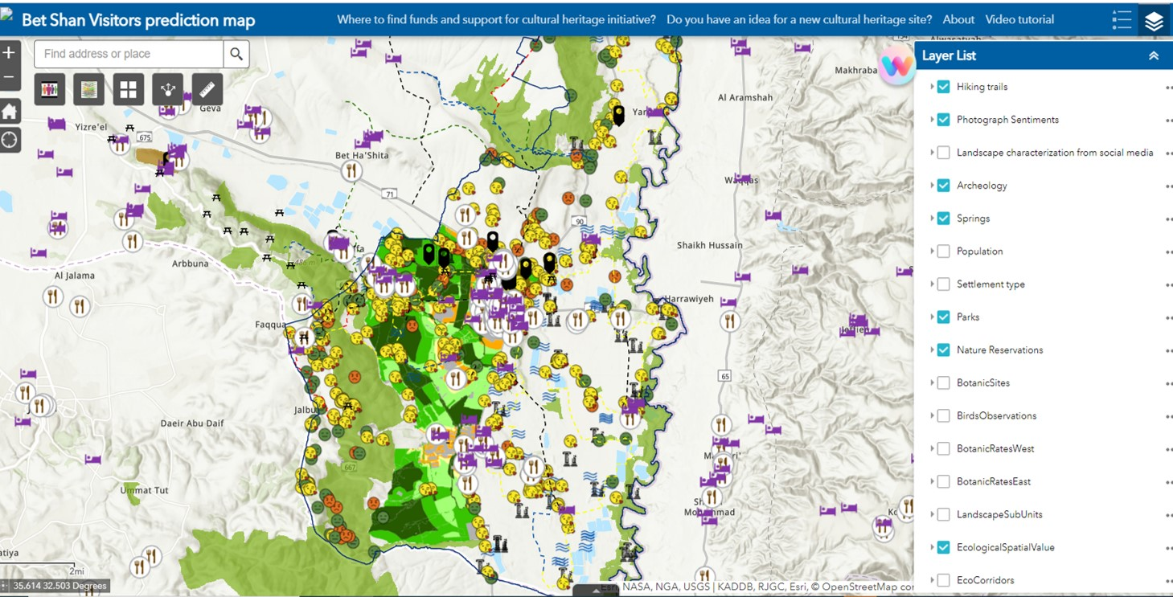
WP3: SPOT-IT
Scientific objectives # 7
30.11.2022
Prof. Michael Sofer & Prof. Anat Tchetchik
https://gis.spotit.site/portal/apps/webappviewer/index.html?id=f8d1ba98020646488a13d2ff6dd4392c

Slide 2
Scientific Objective # 7: SPOT-IT
SO#7: Develop an innovative tool for cultural tourism (CT) in a Web-based resource center, in order to:
(1) facilitate the development of sustainable cultural tourism (CT)
(2) advance policies formulation & implementation of practices in Europe
SPOT-IT is a web-based, user-friendly, collaborative platform.
It is designed to provide multi-criteria decision-supporting information for various stakeholders who have interest in CT development in a given place with emphasis on peripheral de-industrialized areas
The tool was first developed and tested on an ArcGIS Server that was deployed on Microsoft Azure: Cloud Computing Services.
After the testing period, we converted to on-premises deployment.

Slide 3
Scientific Objective # 7: SPOT-IT
.
How did we develop the concept of the innovative tool? by identifying :
its objectives: realize existing/potential opportunities to develop CT, promote local/regional development and, increase Europeanisation
Its stakeholders: Tourism officials, planning authorities, entrepreneurs, local residents, ethnic and other minorities who can be empowered
(3) Sources of data availability: either primary- through interviews with experts, officials, residents or secondary: censuses, official public data, SM.
Corresponds with SO#4: to harness CT to develop social and economic cohesion regarding minorities, women and young people.
Based on these dimensions, we designed and generated its components and their mutual interactions.
Notes:
IT=Innovative Tool In particular, this tool can help support long-term planning that includes spatial elements, infrastructure, climate, zoning, and other considerations.
The tool is designed for entrepreneurs, officials at local authorities, planners, and other stakeholders

Slide 4
SPOT-IT : components – data layers
SPOT-IT delivers georeferenced data related to (cultural) tourism:
Transportation,
Tourism infrastructure [accommodations, restaurants, parks, hiking trails],
Data on zoning and land use,
Landscape categorization [based on social media contents],
Climate data [average, max, min]
Potential social conflicts [tourism-development related = expert opinion],
Ecological vulnerability [ecological corridors, endangered species],
Demographics and socio-economic indicators [on the location],
These multiple data layers, their representation, and their integration, stand at the heart of the tool.

Slide 5
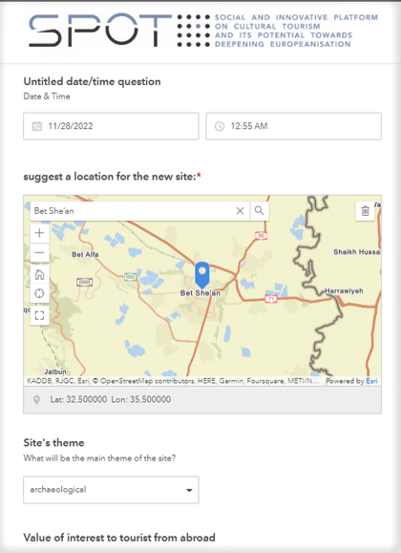
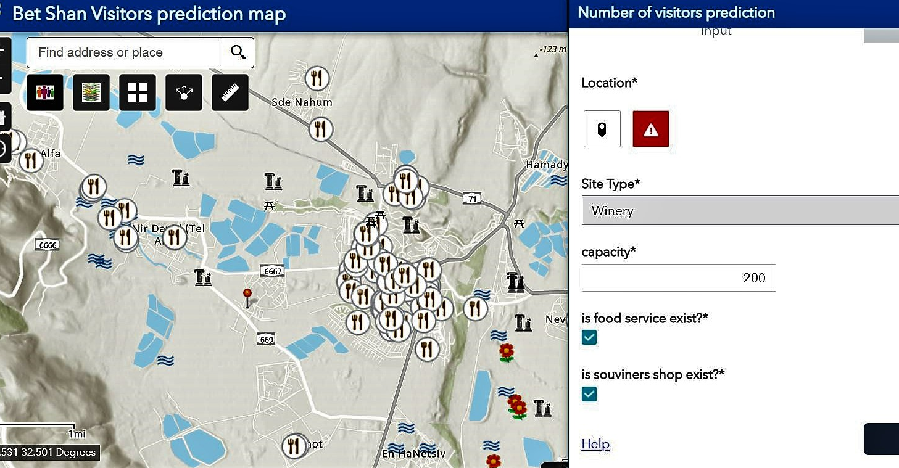
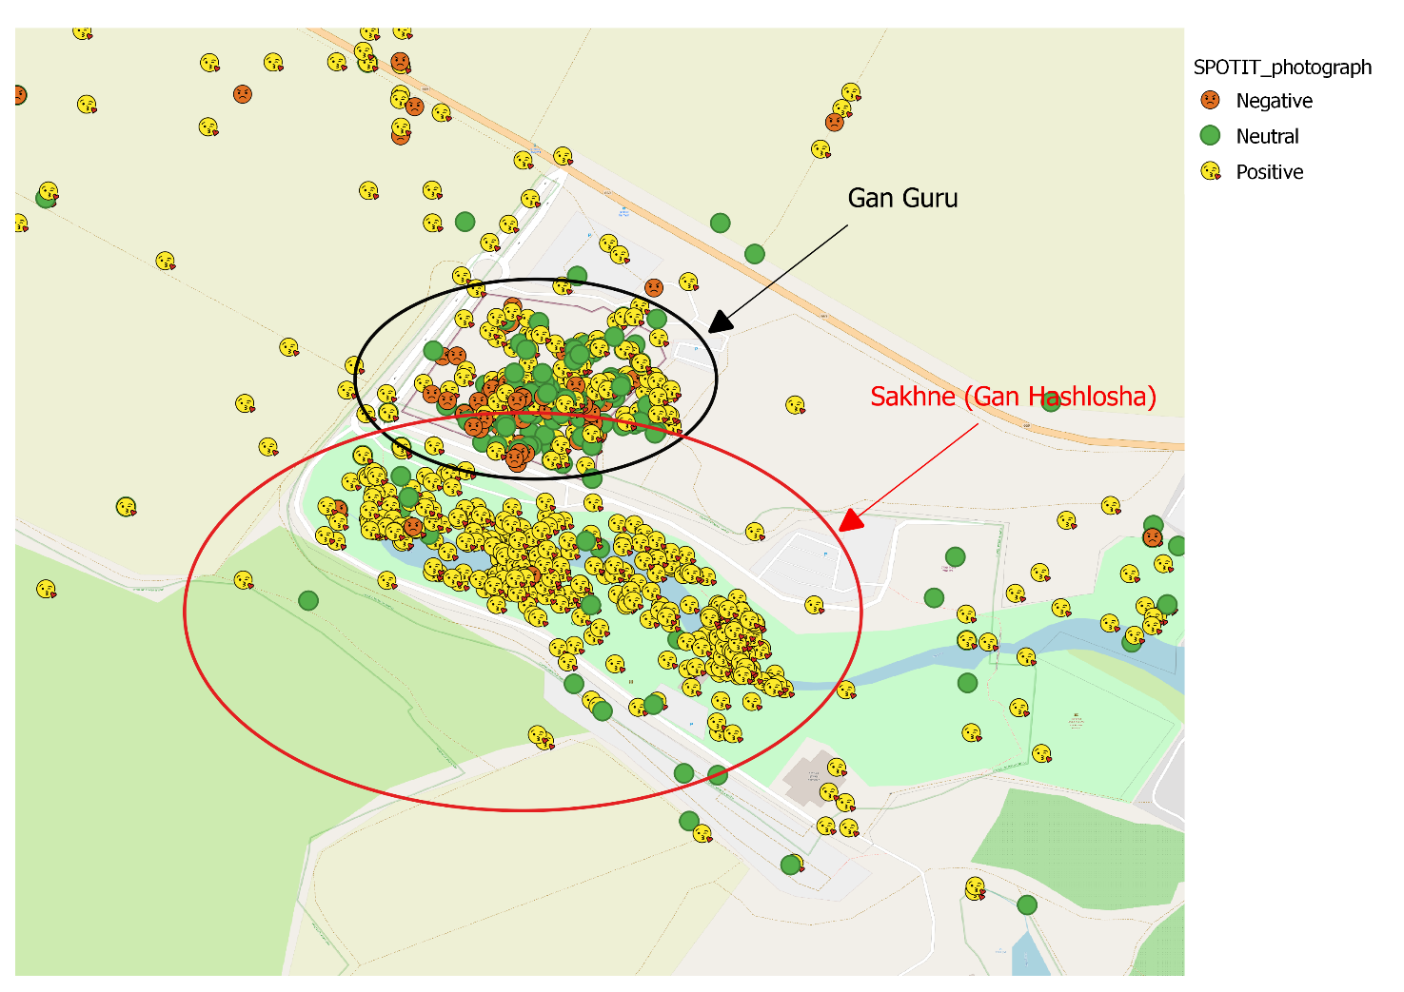
SPOT-IT : additional components
In addition to the multiple data layers the tool provides
Suitability analysis allows users to define the desired criteria for initiating/developing cultural tourism sites
Visitors’ prediction function allows users to estimate this for new cultural tourism initiatives
Machine learning-data based on users generated content in social media.
Public participation platform allows the local community to actively participate in the process of cultural tourism development
Layers were ranked on a 1-5 scale where 1 indicates the least favorable conditions (e.g., in the climate layer, 1 was endowed to ‘very hot’ pixels). This results with maps where each pixel is characterized by a (layer-by-layer) summation.
This layer provides more reliable information compared to Google ratings which might be biased.

Slide 6
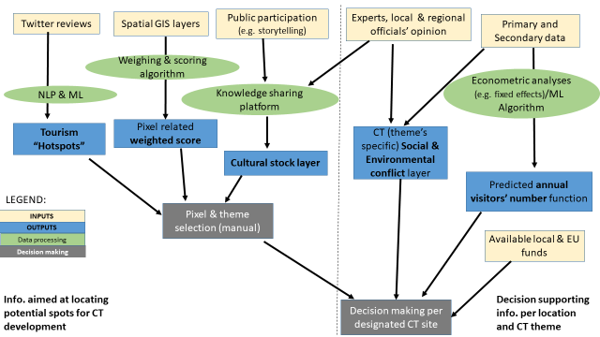
The logical block scheme of the SPOT-IT
Potential social conflicts (per theme)
Potential for new cultural sites
PPi
Users’ pixel selection
Decision making per specific CT site

Slide 7
Examples for SPOT-IT importance
The tool allows an examination of a cultural site’s tangible and intangible assets, accessibility, and related tourism services.
The tool can encourage structured idea exchange (outside-the-box thinking) between people involved in the CT industry, local residents and administrations.
SPOT-IT can help identify required infrastructure investments by enabling visual observations on existing and absent infrastructure.
SPOT-IT can help in marketing the area by stressing its unique CT sites
SPOT-IT can help identify clusters of compatible cultural assets that may attract tourists to the region, and help them optimize the experience.

Slide 8
Examples for SPOT-IT importance
In sum:
SPOT-IT can help realize the local and regional economic, social and other benefits of cultural tourism in a sustainable manner
Future extensions of the tool can include the option to book sites, shows and festivals, communicate with site operators and other visitors, leave feedback etc.
While the conceptualization of the tool is universal, its specifications are place-dependent: each location should develop it based on its needs and specific characteristics.

Slide 9
Several policy recommendations
1. It is recommended to involve stakeholders from the beginning of the process and harness the local officials.
2. After the project ends, the responsibility for the operation of the tool, including its maintenance, and regular updates, should be givern to local level tourism departments/councils
3. Procedures for regular/ongoing updates of the tool should be established: including data on new tourism sites (or the closure of existing ones), new infrastructure (e.g., transportation), updated socio-economic-demographical data, zoning etc.
4. The entities responsible for the maintenance of the tool should ensure its accessibility to all stakeholders, yet, only authorized bodies can access to edit data.

Slide 10
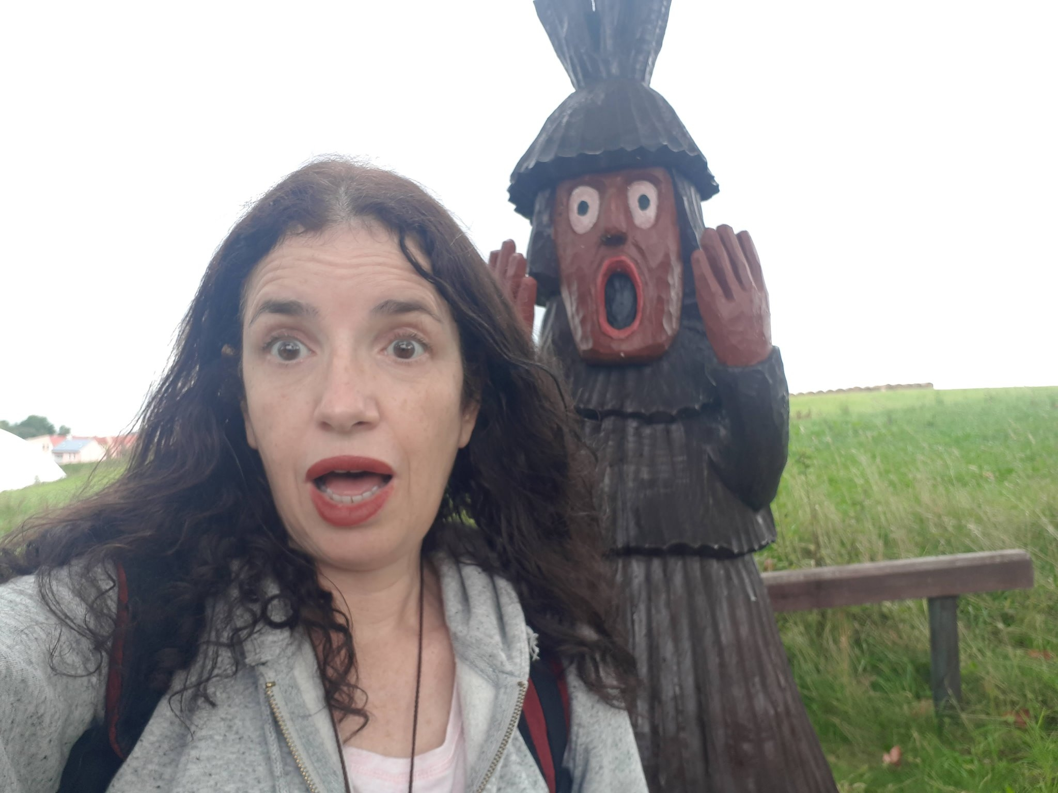
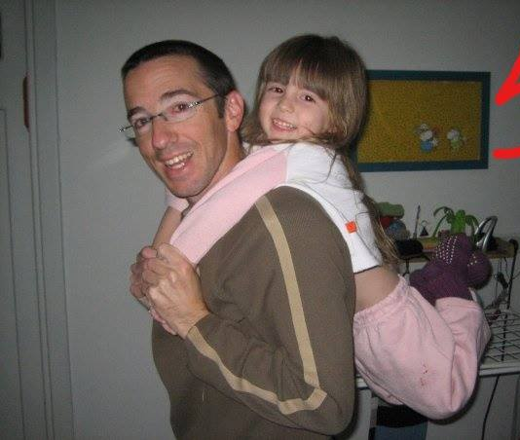
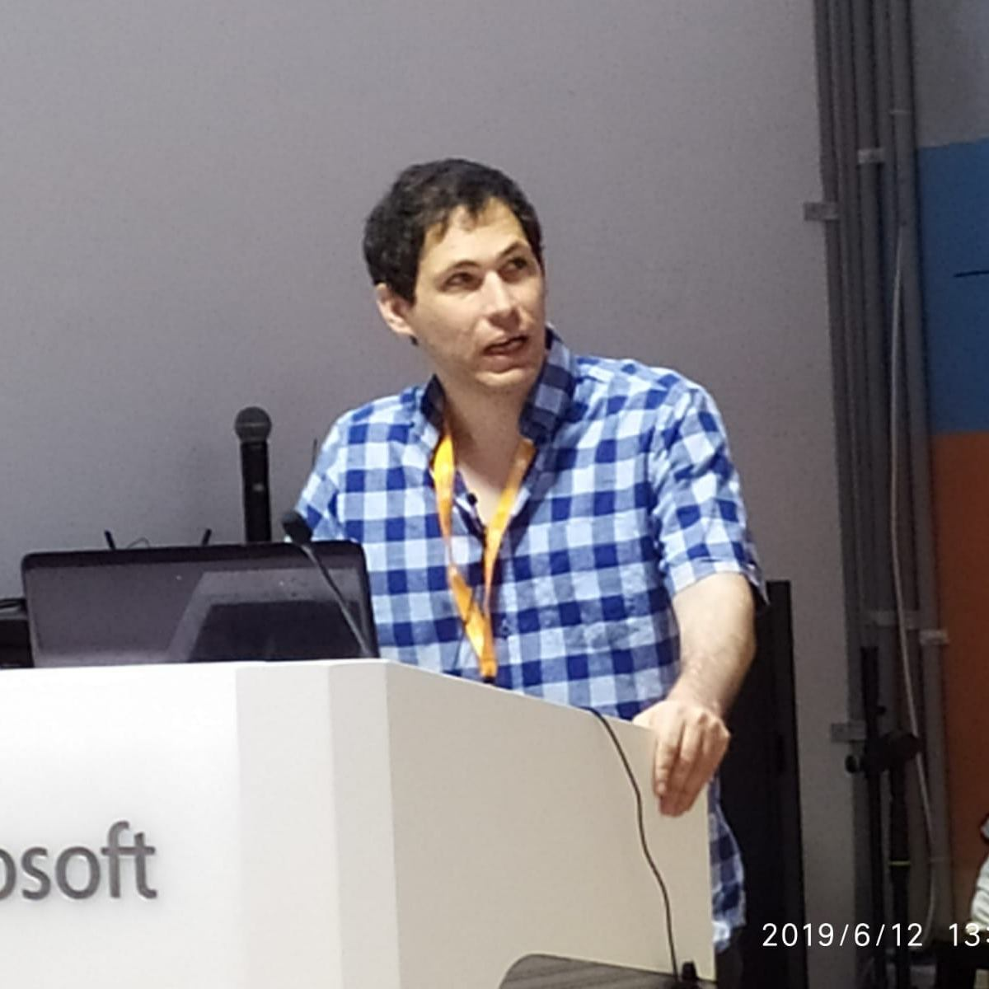
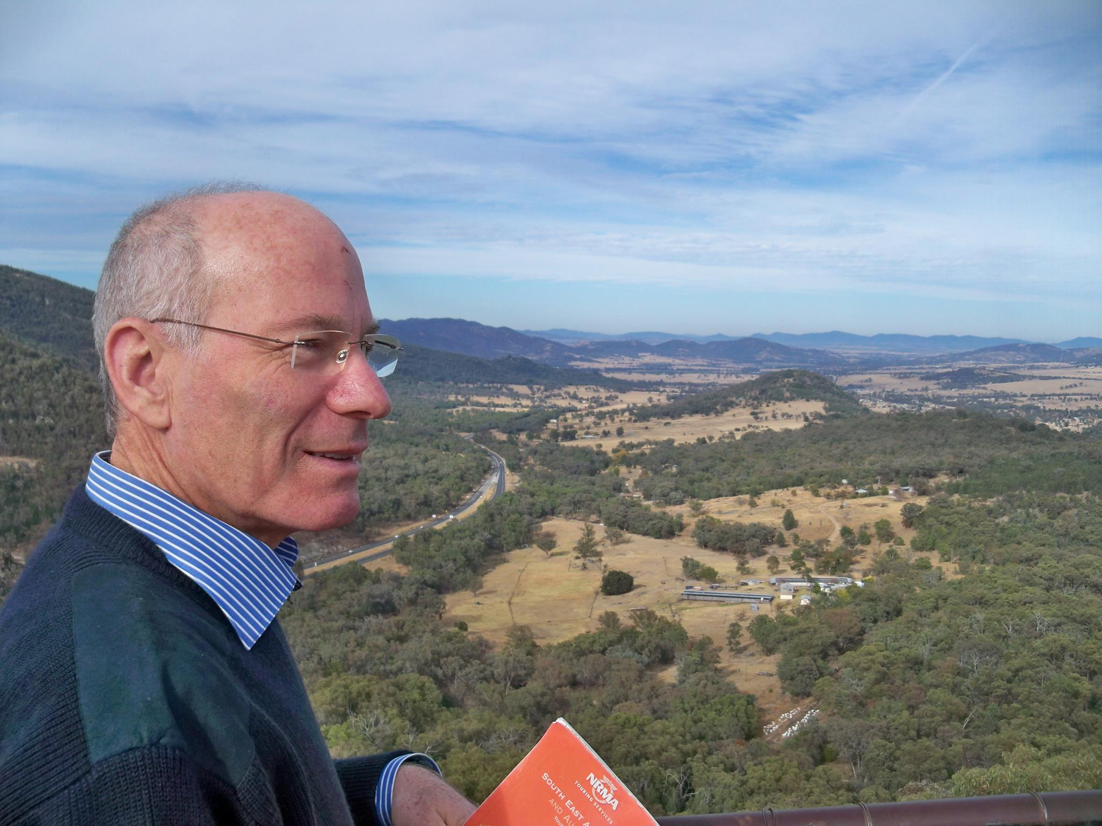
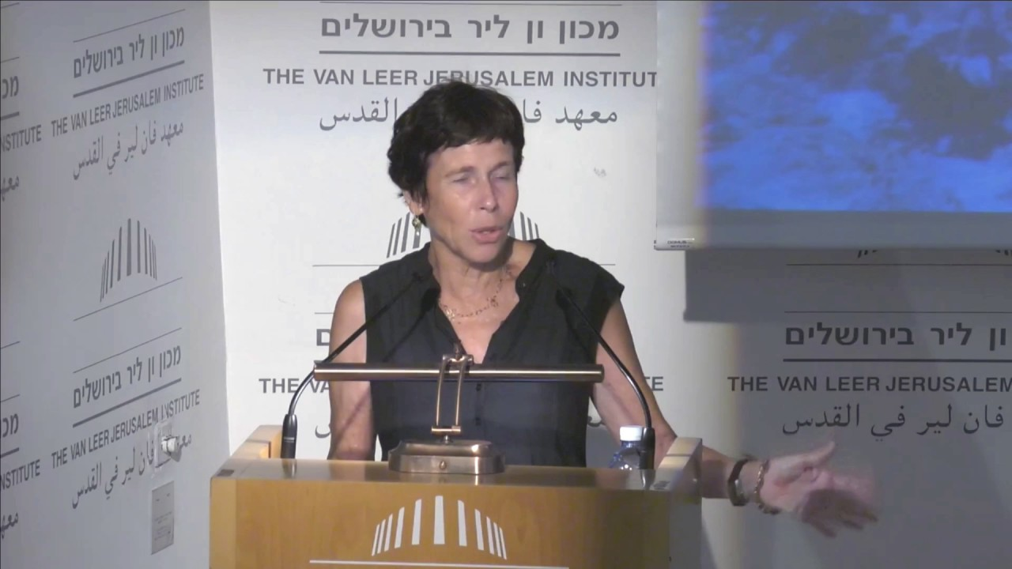
Dr. Irit Shmuel
Dr. Yaron Michael
(Soon to be Dr.) Shilo Shiff
Prof. Irit Amit Cohen
Prof. Michael Sofer
Prof. Anat Tchetchik
Thank you very much for your attention! (Toda Raba!)

